Slide 1
Data Structure and Algorithm BST and Heap

Slide 2
Binary search tree (BST)
Binary search tree (BST) is a node-based binary tree data structure which has the following properties:
The left sub tree of a node contains only nodes with keys less than the root node's key.
The right sub-tree of a node contains only nodes with keys greater than the root node's key.
Both the left and right sub-trees must also be binary search trees.

Slide 3
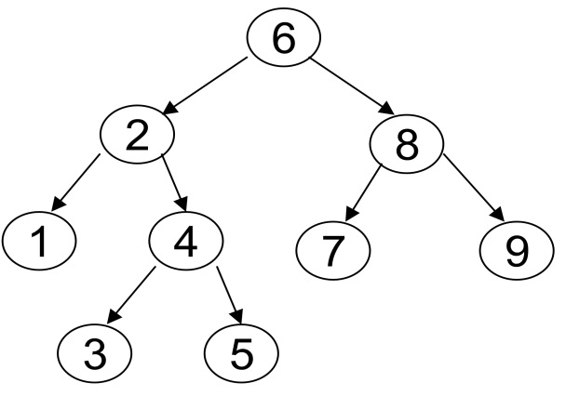
BST
From the above properties it naturally follows that:

Slide 4
Program: Creating a Binary Search Tree
We assume that every node of a binary search tree is capable of holding an integer data item and that the links can be made to point to the root of the left subtree and the right subtree, respectively. Therefore, the structure of the node can be defined using the following declaration:

Slide 5
Binary Search Tree Class Definition
struct node
{
int info;
struct node *left;
struct node *right;
};
class BST
{
public:
void find(int, node **, node **);
void insert(node *, int);
void preorder(node *);
void inorder(node *);
void postorder(node *);
void display(node *, int);
BST();
node *root;
}

Slide 6
Binary Search Tree Insert
void BST::insert(node *tree, int data)
{
node *newnode;
newnode = new node;
newnode->info=data;
if (root == NULL)
{
root = new node;
root->info = newnode->info;
root->left = NULL;
root->right = NULL;
cout<<"Root Node is Added"<<endl;
return;
}

Slide 7
Binary Search Tree Insert
if (tree->info == newnode->info)
{
cout<<"Element already in the tree"<<endl;
return;
}
if (tree->info > newnode->info)
{
if (tree->left != NULL)
{
insert(tree->left, newnode->info);
}
else
{
tree->left = newnode;
(tree->left)->left = NULL;
(tree->left)->right = NULL;
cout<<"Node Added To Left"<<endl;
return;
} }

Slide 8
Binary Search Tree Insert
else
{
if (tree->right != NULL)
{
insert(tree->right, newnode->info);
}
else
{
tree->right = newnode;
(tree->right)->left = NULL;
(tree->right)->right = NULL;
cout<<"Node Added To Right"<<endl;
return;
}
}

Slide 9
Operation on BST
OPERATIONS
Operations on a binary tree require comparisons between nodes.
These comparisons are made with calls to a comparator, which is a subroutine that computes the total order (linear order) on any two values.
This comparator can be explicitly or implicitly defined, depending on the language in which the BST is implemented.
The following are the operations that are being done in Binary Tree
Searching.
Sorting.
Deletion.
Insertion.

Slide 10
Applications of Trees
1. Compiler Design.
2. Unix / Linux.
Database Management.
dynamic dictionary
4. Trees are very important data structures in computing.
5. They are suitable for:
a. Hierarchical structure representation, e.g.,
i. File directory.
ii. Organizational structure of an institution.
iii. Class inheritance tree.
b. Problem representation, e.g.,
i. Expression tree.
ii. Decision tree.
C. Efficient algorithmic solutions, e.g.,
i. Search trees.
ii. Efficient priority queues via heaps.

Slide 11
Binary Heap
A heap is a specialized complete tree structure that satisfies the heap property:
it is empty or the key in the root is larger than that in either child and both subtrees have the heap property.
In general heap is a group of things placed or thrown, one on top of the other.
In data structures a heap is a binary tree storing keys at its nodes.
Heaps are based on the concepts of a complete tree

Slide 12
Heap Order Property :
The property that allows operations to be performed quickly is a heap order property.
Mintree:
Parent should have lesser value than children.
Maxtree:
Parent should have greater value than children.
These two properties are known as heap properties
Max-heap
Min-heap
Min-heap:
The smallest element is always in the root node. Each node must have a key that is less or equal to the key of each of its children.
Examples

Slide 13
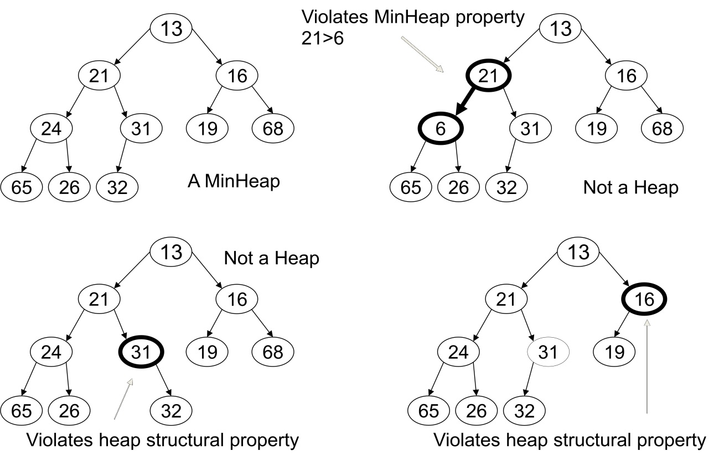
Example

Slide 14
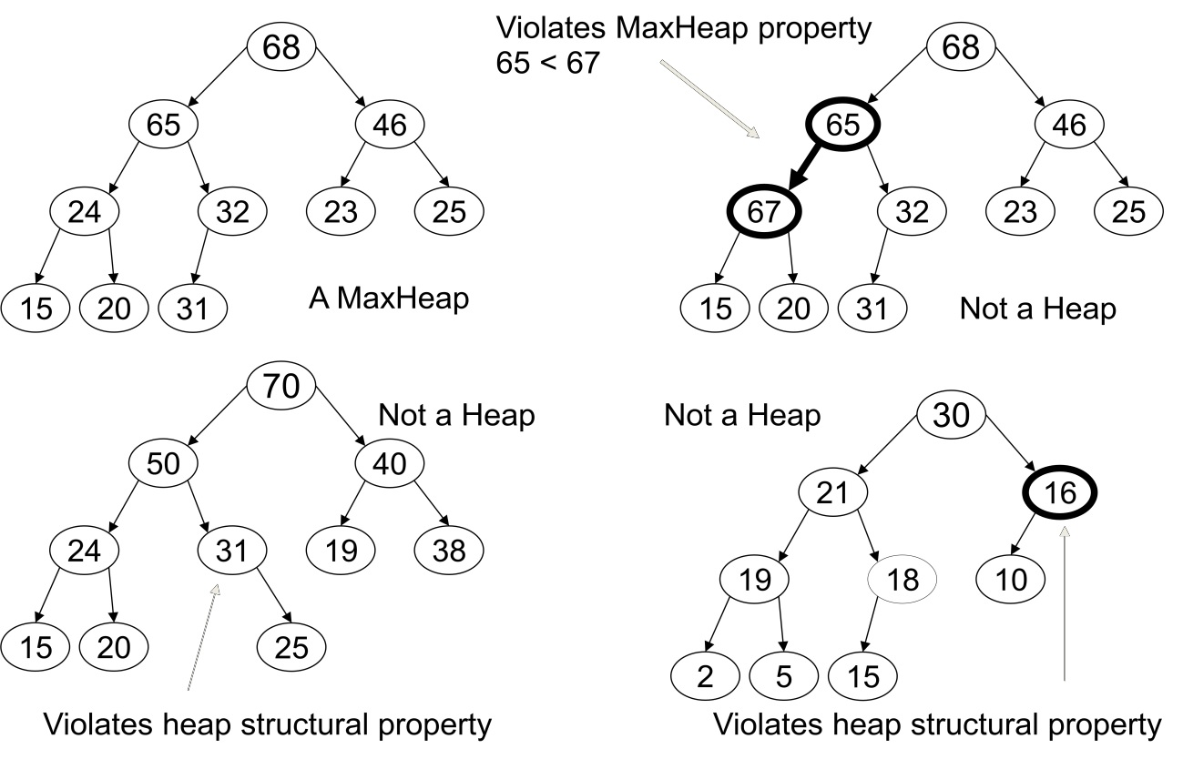
Max-Heap:
The largest Element is always in the root node.
Each node must have a key that is greater or equal to the key of each of its children.

Slide 15
Heaps
Root
A heap is a certain kind of complete binary tree.
When a complete
binary tree is built,
its first node must be
the root.
Notes:
The first node of a complete binary tree is always the root...

Slide 16
Heaps
Complete binary tree.
Left child
of the
root
The second node is
always the left child
of the root.
Notes:
...the second node is always the left child of the root...

Slide 17
Heaps
Complete binary tree.
Right child
of the
root
The third node is
always the right child
of the root.
Notes:
...then the right child of the root...

Slide 18
Heaps
Complete binary tree.
The next nodes
always fill the next
level from left-to-right.
Notes:
...and so on. The nodes always fill each level from left-to-right...

Slide 19
Heaps
Complete binary tree.
The next nodes
always fill the next
level from left-to-right.
Notes:
...from left-to-right...

Slide 20
Heaps
Complete binary tree.
The next nodes
always fill the next
level from left-to-right.
Notes:
...from left-to-right...

Slide 21
Heaps
Complete binary tree.
The next nodes
always fill the next
level from left-to-right.
Notes:
...from left-to-right...

Slide 22
Heaps
Complete binary tree.
Notes:
...and when a level is filled you start the next level at the left.

Slide 23
Heaps
A heap is a certain kind of complete binary tree.
45
35
23
27
21
22
4
19
Each node in a heap
contains a key that
can be compared to
other nodes' keys.
Notes:
So, a heap is a complete binary tree. Each node in a heap contains a key, and these keys must be organized in a particular manner. Notice that this is not a binary search tree, but the keys do follow some semblance of order.
Can you see what rule is being enforced here?

Slide 24
Heaps
A heap is a certain kind of complete binary tree.
45
35
23
27
21
22
4
19
The "heap property"
requires that each
node's key is >= the
keys of its children
Notes:
The heap property requires that each node's key is >= to the keys of its children.
This is a handy property because the biggest node is always at the top. Because of this, a heap can easily implement a priority queue (where we need quick access to the highest priority item).

Slide 25
Implementing a Heap
42
We will store the data from the nodes in a partially-filled array.
35
23
27
21
An array of data
Notes:
This slide shows the typical way that a heap is implemented. For the most part, there is nothing new here, because you already know how to implement a complete binary tree using a partially-filled array. That is what we are doing with the heap.

Slide 26
Implementing a Heap
42
Data from the root goes in the first location of the array.
35
23
27
21
42
An array of data
Notes:
Following the usual technique for implementing a complete binary tree, the data from the root is stored in the first entry of the array.

Slide 27
Implementing a Heap
42
Data from the next row goes in the next two array locations.
35
23
27
21
42
35
23
An array of data
Notes:
The next two nodes go in the next two locations of the array.

Slide 28
Implementing a Heap
42
Data from the next row goes in the next two array locations.
35
23
27
21
42
35
23
27
21
An array of data
Notes:
and so on.

Slide 29
Implementing a Heap
42
Data from the next row goes in the next two array locations.
35
23
27
21
42
35
23
27
21
An array of data
We don't care what's in
this part of the array.
Notes:
As with any partially-filled array, we are only concerned with the front part of the array. If the tree has five nodes, then we are only concerned with the entries in the first five components of the array.

Slide 30
Important Points about the Implementation
42
The links between the tree's nodes are not actually stored as pointers, or in any other way.
The only way we "know" that "the array is a tree" is from the way we manipulate the data.
35
23
27
21
42
35
23
27
21
An array of data
Notes:
With this implementation of a heap, there are no pointers. The only way that we know that the array is a heap is the manner in which we manipulate it.

Slide 31
Important Points about the Implementation
42
If you know the index of a node, then it is easy to figure out the indexes of that node's parent and children. Formulas are given in the book.
35
23
27
21
42
35
23
27
21
[1] [2] [3] [4] [5]
Notes:
The manipulations are the same manipulations that you've used for a complete binary tree, making it easy to compute the index where various nodes are stored.

Slide 32
Adding a Node to a Heap
Put the new node in the next available spot.
Push the new node upward, swapping with its parent until the new node reaches an acceptable location.
45
35
23
27
21
22
4
19
42
Notes:
We can add new elements to a heap whenever we like. Because the heap is a complete binary search tree, we must add the new element at the next available location, filling in the levels from left-to-right.
In this example, I have just added the new element with a key of 42.
Of course, we now have a problem: The heap property is no longer valid. The 42 is bigger than its parent 27.
To fix the problem, we will push the new node upwards until it reaches an acceptable location.

Slide 33
Adding a Node to a Heap
Put the new node in the next available spot.
Push the new node upward, swapping with its parent until the new node reaches an acceptable location.
45
35
23
42
21
22
4
19
27
Notes:
Here we have pushed the 42 upward one level, swapping it with its smaller parent 27.
We can't stop here though, because the parent 35 is still smaller than the new node 42.

Slide 34
Adding a Node to a Heap
Put the new node in the next available spot.
Push the new node upward, swapping with its parent until the new node reaches an acceptable location.
45
42
23
35
21
22
4
19
27
Notes:
Can we stop now? Yes, because the 42 is less than or equal to its parent.

Slide 35
Adding a Node to a Heap
The parent has a key that is >= new node, or
The node reaches the root.
The process of pushing the new node upward is called reheapup.
45
42
23
35
21
22
4
19
27
Notes:
In general, there are two conditions that can stop the pushing upward:
1. We reach a spot where the parent is >= the new node, or
2. We reach the root.
This process is called reheapification upward (I didn't just make up that name, really).

Slide 36
Removing the Top of a Heap
45
Move the last node onto the root.
42
23
35
21
22
4
19
27
Notes:
We can also remove the top node from a heap. The first step of the removal is to move the last node of the tree onto the root. In this example we move the 27 onto the root.

Slide 37
Removing the Top of a Heap
27
Move the last node onto the root.
42
23
35
21
22
4
19
Notes:
Now the 27 is on top of the heap, and the original root (45) is no longer around. But the heap property is once again violated.

Slide 38
Removing the Top of a Heap
Move the last node onto the root.
Push the out-of-place node downward, swapping with its larger child until the new node reaches an acceptable location.
27
42
23
35
21
22
4
19
Notes:
We'll fix the problem by pushing the out-of-place node downward. Perhaps you can guess what the downward pushing is called....reheapification downward.

Slide 39
Removing the Top of a Heap
Move the last node onto the root.
Push the out-of-place node downward, swapping with its larger child until the new node reaches an acceptable location.
42
27
23
35
21
22
4
19
Notes:
When we push a node downward it is important to swap it with its largest child. (Otherwise we are creating extra problems by placing the smaller child on top of the larger child.) This is what the tree looks like after one swap.
Should I continue with the reheapification downward?

Slide 40
Removing the Top of a Heap
Move the last node onto the root.
Push the out-of-place node downward, swapping with its larger child until the new node reaches an acceptable location.
42
35
23
27
21
22
4
19
Notes:
Yes, I swap again, and now the 27 is in an acceptable location.

Slide 41
Removing the Top of a Heap
The children all have keys <= the out-of-place node, or
The node reaches the leaf.
The process of pushing the new node downward is called reheapdown.
42
35
23
27
21
22
4
19
Notes:
Reheapification downward can stop under two circumstances:
1. The children all have keys that are <= the out-of-place node.
2. The out-of-place node reaches a leaf.

Slide 42
AVL TREE
The AVL tree is named after its two inventors, G.M. Adelson-Velsky and E.M. Landis, who published it in their 1962 paper "An algorithm for the organization of information."
Avl tree is a self-balancing binary search tree. In an AVL tree, the heights of the two child subtrees of any node differ by at most one; therefore, it is also said to be height-balanced.
The balance factor of a node is the height of its right subtree minus the height of its left subtree and a node with balance factor 1, 0, or -1 is considered balanced. A node with any other balance factor is considered unbalanced and requires rebalancing the tree. This can be done by avl tree rotations

Slide 43
Need for AVL tree
The disadvantage of a binary search tree is that its height can be as large as N-1
This means that the time needed to perform insertion and deletion and many other operations can be O(N) in the worst case
We want a tree with small height
A binary tree with N node has height at least Q(log N)
Thus, our goal is to keep the height of a binary search tree O(log N)
Such trees are called balanced binary search trees. Examples are AVL tree, red-black tree
Thus we go for AVL tree.

Slide 44
APPLICATIONS of AVL Tree
AVL trees play an important role in most computer related
applications. The need and use of avl trees are increasing
day by day. their efficiency and less complexity add value
to their reputation.
Some of the applications are
Contour extraction algorithm
Parallel dictionaries
Compression of computer files
Translation from source language to target language
Spell checker

Slide 45
DISADVANTAGES OF AVL TREE
one limitation is that the tree might be spread across memory
as you need to travel down the tree, you take a performance hit at every level down
one solution: store more information on the path
Difficult to program & debug ; more space for balance factor.
asymptotically faster but rebalancing costs time.
most larger searches are done in database systems on disk and use other structures

